Slide 1
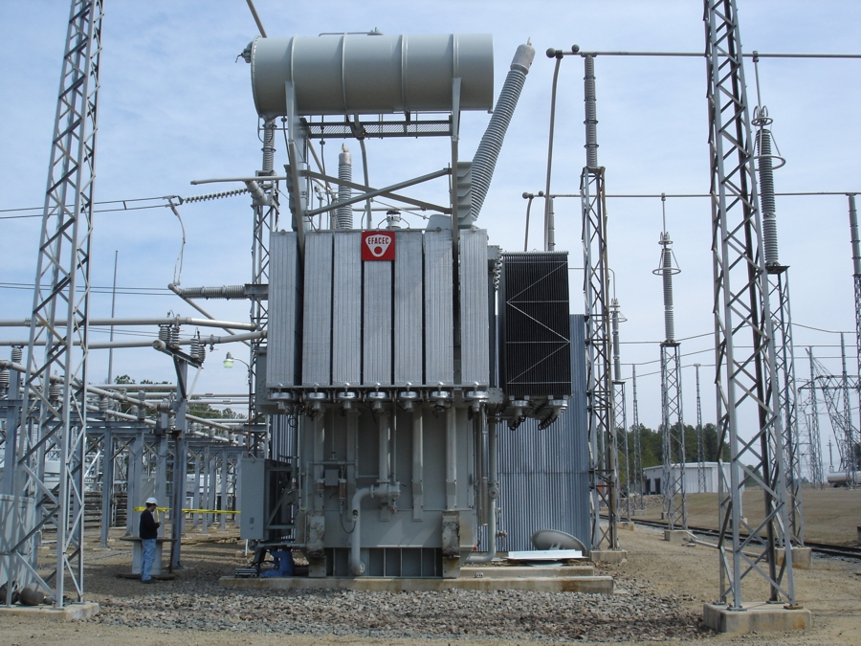


Slide 2
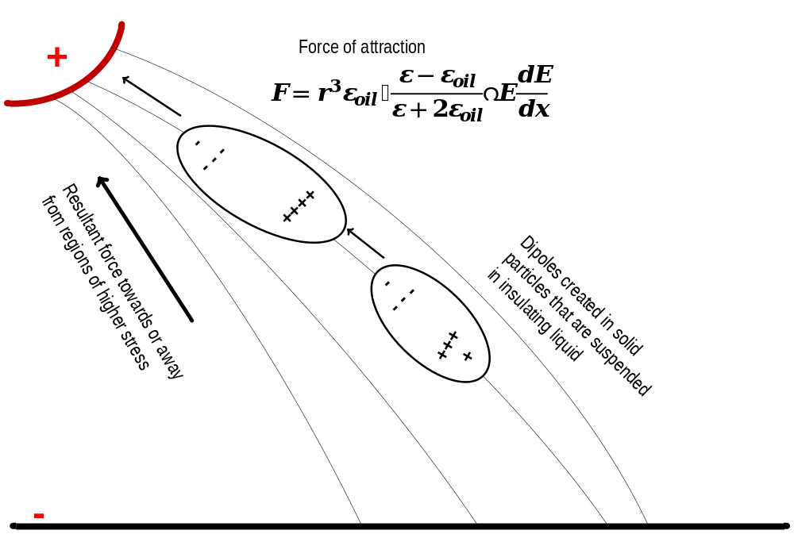
Liquid insulation failure mechanisms due to suspended particles

